Slide 1

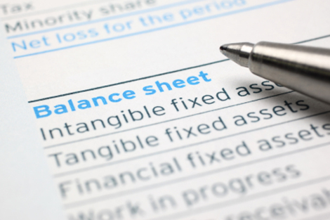
Unit 3: Financial Statements

Slide 2
Content
Basics in preparation of final Accounts –Theory, Basic adjustments in preparation of final Accounts- Theory, Preparation of company final accounts, Basic adjustments in preparation of company final Accounts, Preparation of Horizontal format final accounts of Company, Preparation of Vertical format final accounts of Company

Slide 3
Introduction
When a student has studied for a year, he/she wants to know how much he/she has learnt during that period.
Similarly, every business enterprise wants to know the result of its activities of a particular period which is generally one year and what is its financial position on a particular date which is at the end of this period. For this, it prepares various statements which are called the financial statements.

Slide 4
Meaning of Financial Statement
Financial statements are the statements that are prepared at the end of the accounting period, which is generally one year.
These include income statement i.e. Trading and Profit & Loss Account and Position statement i.e. Balance Sheet.

Slide 5
Objectives of financial statements
Ascertaining the results of business operations.
Ascertaining the financial position.
Source of information.
Helps in managerial decision making.
An index of solvency of the concern.

Slide 6
Features of Financial Statement
Financial statements are always expressed in monetary terms.
Financial statements are always prepared for a certain period of time.
Financial statements are historical in nature since they always present the past performance.
Information needs to be understandable by users.
The relevance of financial information relates to its predictive value, as well as its usefulness in helping users
Reliability involves providing information that represents transactions or events faithfully, in accordance with their substance and economic reality.
Comparability requires consistency in the use and application of accounting policies

Slide 7
Types of financial Statements
Income Statement (Trading & Profit and Loss Account) - revenues minus expenses for a given time period ending at a specified date.
Balance Sheet - statement of financial position at a given point in time.
Statement of Owner's Equity - also known as Statement of Retained Earnings or Equity Statement.
Statement of Cash Flows - summarizes sources and uses of cash; indicates whether enough cash is available to carry on routine operations.

Slide 8
Trading Account
Income statement consists of Trading and Profit and Loss Account.
A business firm either purchases goods from others and sells them or manufactures and sells them to earn profit. This is known as trading activities.
A statement is prepared to know the results in terms of profit or loss of these activities. This statement is called Trading Account

Slide 9
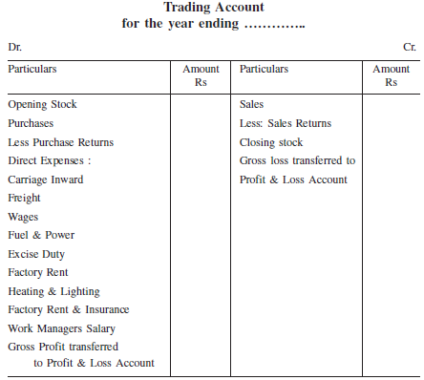
Format of Trading Account

Slide 10
Objectives for preparing trading Account
Knowledge of Gross Profit
Knowledge of All Direct expenses
Precaution against future losses

Slide 11
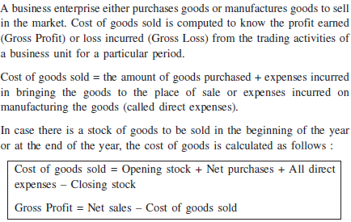
Cost of Goods Sold & gross Profit

Slide 12
Problem 1
Prepare Trading Account for the year ending 31st March 2012 from the following information.
Opening stock Rs. 1,70,000, Purchases return Rs. 10,000, Sales Rs.2,50,000, Wages Rs. 50,000,Sales return Rs. 20,000 Purchases Rs. 1,00,000,Carriage inward Rs. 20,000 Closing stock Rs. 1,60,000

Slide 13
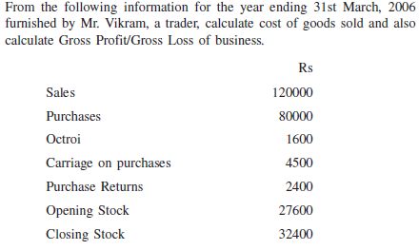
Problem 2

Slide 14
Profit and Loss Account
The Profit and loss account is an account which shows the net profit or net loss of a business for a particular year.
The net profit or net loss is the profit earned or loss suffered after charging all business expenses (including depreciation and provisions).
It is the final profit or loss of a business.

Slide 15
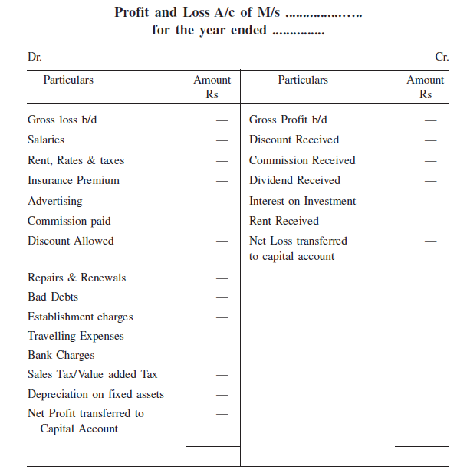
Profit and Loss Account- Format

Slide 16
Balance Sheet
It is a statement showing the position of the assets and liabilities of the business on the last day of the accounting year or on the date on which it is prepared. A balance sheet depicts the financial position of the business.
Balances of real and personal accounts and are grouped as assets and liabilities.
They are arranged in a proper way in the form of a statement which is called a balance sheet or a position statement. When balance sheet is represented in a 'T' from, assets are shown on the right hand side and liabilities are shown on the left hand side.

Slide 17
Marshaling of Balance Sheet
The arrangement of the different items of assets and liabilities in a balance sheet is called marshaling of balance sheet. This can be done in two ways
(i) In order of liquidity
(ii) In order of permanence

Slide 18
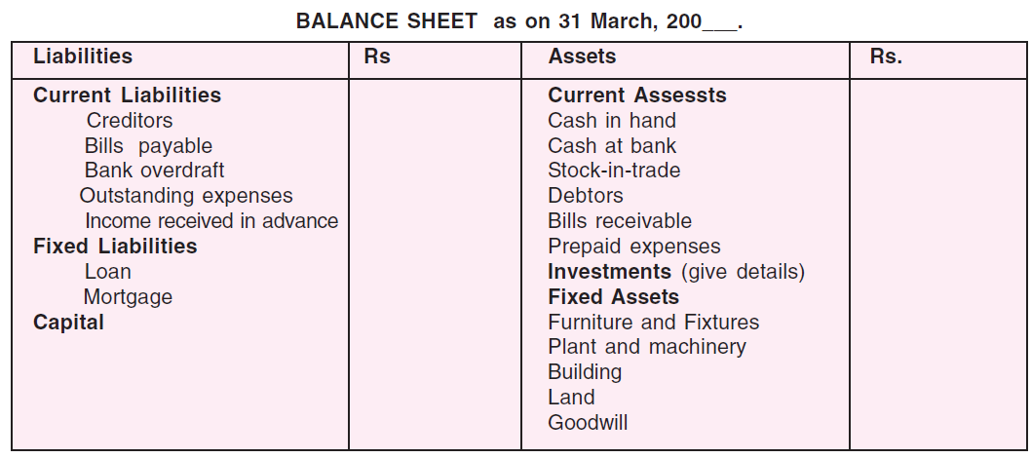
In Order of Liquidity

Slide 19
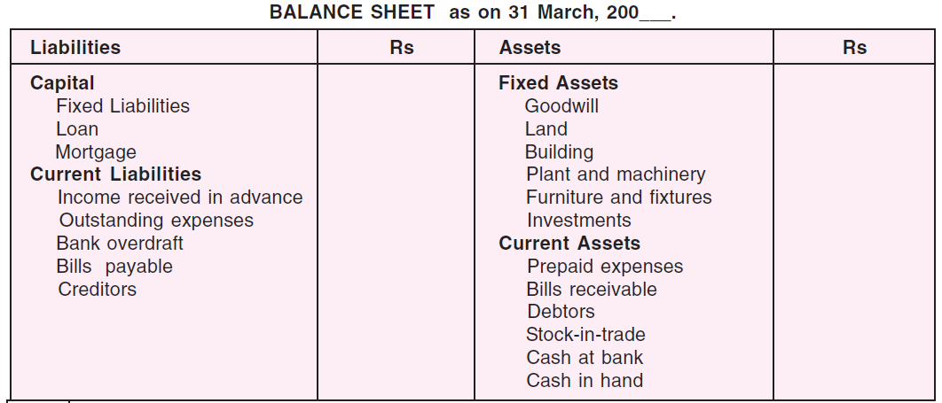
Order of permanence

Slide 20
Adjustments
It is possible that there are certain items of income or expenses which do not pertain to the accounting period for which Trial Balance is prepared or other such items which have accrued but have not been accounted for and hence are not reflected in Trial Balance.
Both these types of incomes and expenses are to be fully accounted for, only then the above stated two statements will show the true and fair position of the business. These are called ‘adjustments’.

Slide 21
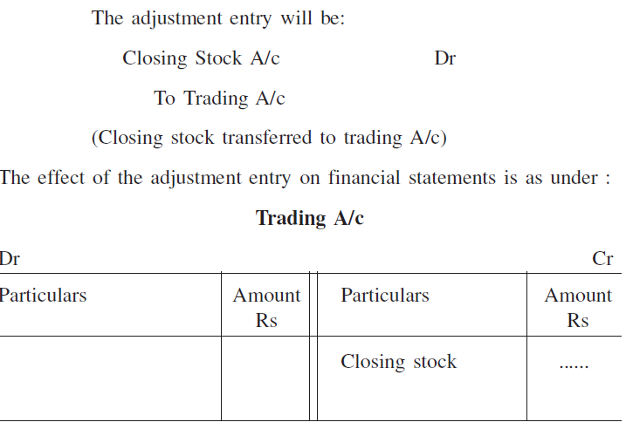
Closing Stock
Closing Stock is the stock of goods remaining unsold at the end of the accounting year.

Slide 22
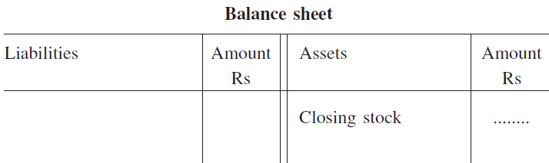
Closing Stock

Slide 23
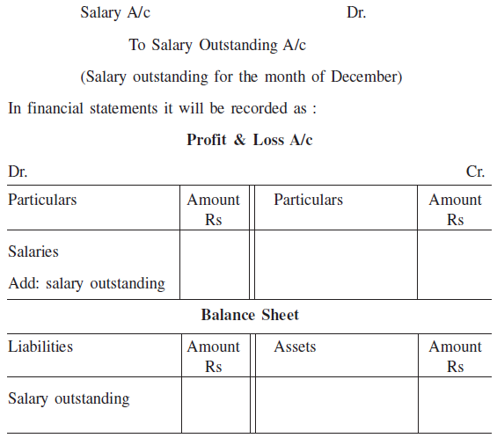
Outstanding Expenses
Expense which is related to the current accounting period but not yet paid is known as Outstanding Expense.

Slide 24
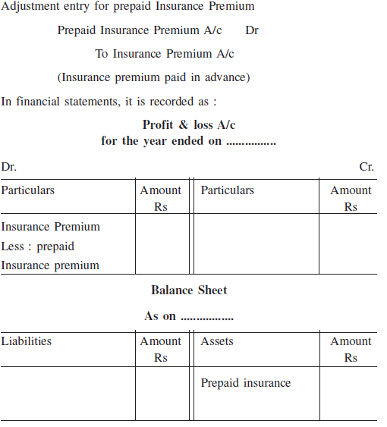
Prepaid Expenses
Sometimes a part of a certain expense paid may relate to the next accounting period. Such expenses is called prepaid expense or expenses paid in advance.

Slide 25
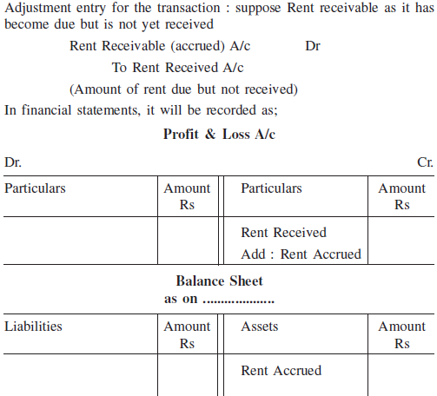
Accrued income (Due but not received)
Accrued income means income earned but not received till the end of the accounting year.

Slide 26

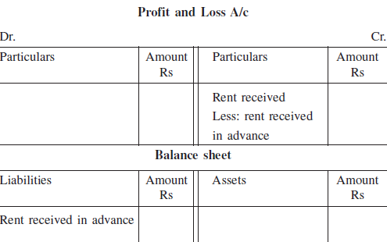
Unearned income/income Received in Advance
Sometimes income is received before it becomes actually due. Such income is called “unearned income” or “income received in advance”.

Slide 27

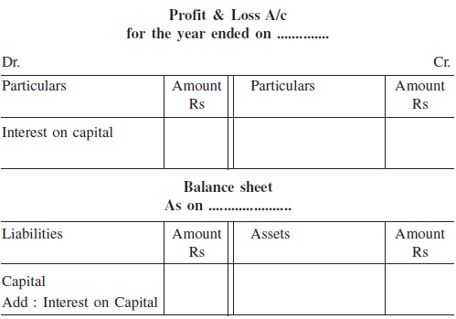
Interest on capital
As per business entity concept capital of the proprietor is a liability for the business. Like other loans interest can be paid on capital also.

Slide 28

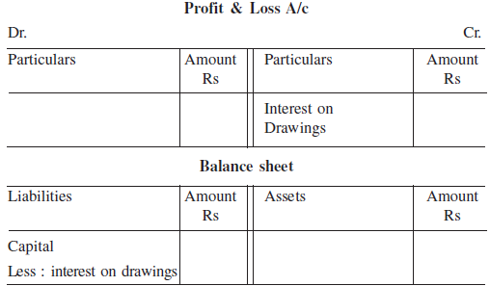
Interest on drawings
Interest may also be charged on money withdrawn by the proprietor for household use.

Slide 29
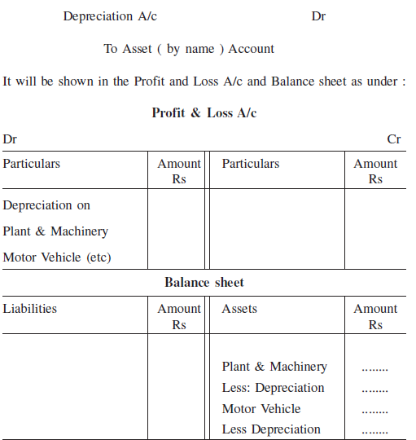
Depreciation
The value of fixed assets such as Plant and Machinery, Furniture and Fixtures, Land & Building, Motor Vehicles etc. goes on reducing year after year due to wear and tear, obsolescence or for any other reason.

Slide 30
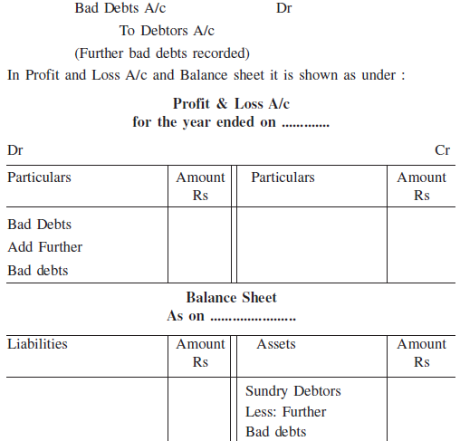
Further Bad Debts
When the goods are sold on credit basis some of the debtors partly pay the due amount or do not pay at all. If this amount cannot be recovered it is called bad debts and is a loss to the firm.

Slide 31
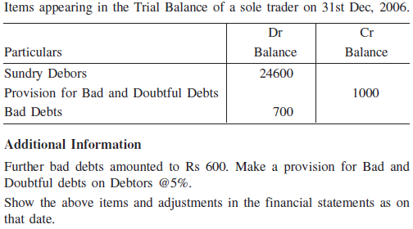
Provision for Bad and Doubtful debts
It will be a sound accounting practice that a suitable amount is kept aside in the current year to meet the possible loss of bad debts in the next year.
Decision regarding maintenance for provision for Bad Doubtful Debts is taken at the end of the year so it is an item of adjustment. It is called a provision for Bad and Doubtful Debt.

Slide 32
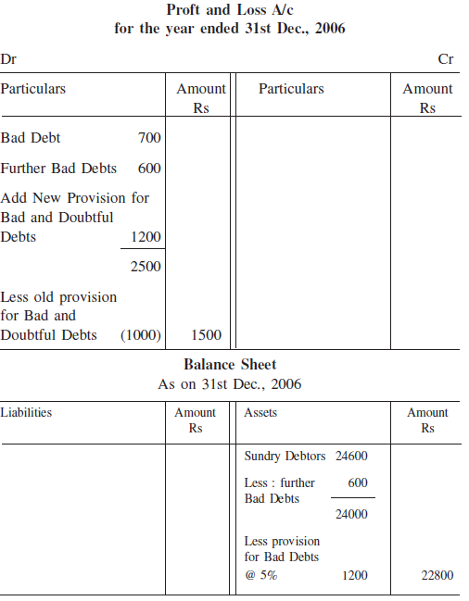
Provision for Bad and Doubtful debts

Slide 33

Provision for Discount on Debtors
A business enterprise allows discount to its debtors to encourage prompt payments. Discount likely to be allowed to customers in an accounting year can be estimated and provided for by creating a provision for discount on debtors.
Provision for discount is made on good debtors which are arrived at by deducting further bad debts and the provision for doubtful debts.
The two fold effect of this entry will be:
Such provision will be shown on the Dr. side of P&L A/c.
It will be shown by way of deduction from sundry debtors(after deduction of further bad debts & the provision for doubtful debts) on the asset side of the Balance Sheet.

Slide 34
Reserve for Discount on creditors
As the firm has to provide for discount on debtors, similarly, the firm may have chance to receive discount on the last date of the accounting year, if the payment is made within the scheduled period.
Reserve for discount on creditors A/c…….Dr.
To Profit & Loss A/c
Two Fold effect in financial Statement is:
Shown in the credit side of the P&L A/c.
Shown in the liability side of the balance sheet as a deduction from sundry creditors

Slide 35
Loss of Stock by fire or theft
In Business, the Loss of Stock may occur by fire or theft. The position of the business may be:
All the Stock is fully insured. (Two Fold effect)
The Stock is partly insured. (Three Fold effect)
The stock is not insured at all. (Two Fold effect)
Trading Account: Cr. Side Loss of goods. (Goods Worth Destroyed)
P&L Account: Dr. Side Amount of loss of goods. (Amount of Loss which cannot be Claimed)
Balance Sheet: Asset side Amount claim form Insurance Co. ( full Amount or Partial Amount claimed as shown in Problem)

Slide 36
Manager’s Commission
The manager of the business is sometimes given the commission on the net profit of the company. The percentage of the commission is applied on the profit either before charging such commission or after charging such commission.
In the absence of any such information, it is assumed that commission is allowed as a percentage of the net profit before charging such commission.
Shown in Dr. side of P&L Account and Under Current Liabilities and Provisions.

Slide 37
Example For Manger’s Commission
Let the net profit of a business is Rs. 110 before charging commission. If the manger is entitled to 10% of the net profit before charging such commission. The commission will be calculated as follows:
Rs.110* 10/100 = Rs.11
In case the commission is 10% of the profit after charging such commission, it will be calculated as :
= Profit before commission* % of commission/ (100 + commission)

Slide 38
Goods distributed as free samples
It must be treated as distributed for advertisement purposes.
Deducted from purchases on the Dr. side of Trading account.
Added to the Advertisement expenses on the Dr. side of P&L Account.

Slide 40
Meaning of Company
A company may be viewed as an association of person who contribute money or money’s worth to a common stock and use it for a common purpose.
It is an artificial person having or corporate legal entity distinct from its members (shareholders) and has a common seal used for its signature.

Slide 41
Features of Company
Voluntary Association
Separate Legal Entity
Limited Liability
Perpetual Succession or continuous existence
Common Seal
Transferability of Shares
May Sue or be Sued
Separation of Ownership from Management

Slide 42
Difference between MOA & AOA
Articles Of Association is the document containing the rules which governs the INTERNAL organization of a limited company. This must be filed with the Registrar of Companies together with the Memorandum Of Association.
The Articles Of Association reflects the following:
Organization and control
Voting rights
Conduct of directors’ meeting
Conduct of shareholders’ annual general meeting
Directors’ power
Rights attached to the different classes of shares

Slide 43
Difference between MOA & AOA
The Memorandum Of Association is the document filed with the Registrar of Companies before a limited company can become incorporated. It defines the EXTERNAL relationship of the company to the outside world.
The details included in the Memorandum of Association are:
The company’s name, address and registered office
Share capital
The company’s objectives

Slide 44
Share and Share Capital of a Company
A company, being an artificial person, cannot generate its own capital which has necessarily to be collected from several persons. These persons are known as shareholders and the amount contributed by them is called share capital.
The Capital of the company is divided into a number of units of fixed value. Each unit is called a “Share”.

Slide 45
Classes of Shares
Equity Shares – represents a real ownership of the company. The holders of the equity shares have voting rights. These shares are also called common stock or ordinary shares or shares with residual claim. The members holding this kind of shares are called Equity Shareholders.
Preference Shares- are shares which have preferential right over the equity shares in respect of dividend and in respect of repayment or refund of capital in the event of liquidation of the company. The members holding this kind of shares are called Preference Shareholders.

Slide 46
Debentures
Sec-2(12) of the Companies Act, 1956 defines debentures as ‘debentures include debenture stock, bonds and any other securities of the company whether constituting a charge on the assets of the company or not’.
A commercial definition of the debenture is an acknowledgement of a debt in writing, given under the seal of the company, containing a contract for the repayment of the principal sum at a specified date and for the payment of interest (usually half yearly) at a fixed rate until the principal sum is repaid.

Slide 47
Categories of Share Capital
Authorised Capital: Authorised capital is the amount of share capital which a company is authorised to issue by its Memorandum of Association. The company cannot raise more than the amount of capital as specified in the Memorandum of Association. It is also called Nominal or Registered capital.
Issued Capital: It is that part of the authorised capital which is actually issued to the public for subscription including the shares allotted to vendors and the signatories to the company’s memorandum. The authorised capital which is not offered for public subscription is known as ‘unissued capital’. Unissued capital may be offered for public subscription at a later date.
Subscribed Capital: That part of the issued capital for which applications are received from the public is called the subscribed capital.

Slide 48
Categories of Share Capital
Called up Capital. The amount on the shares which is actually demanded by the company to be paid is known as called up capital.
Uncalled Capital: That portion of the subscribed capital which has not yet been called-up. As stated earlier, the company may collect this amount any time when it needs further funds.
Paid up Capital. The part of the called up capital which is offered and is actually paid by the members is known as paid up capital. The sum which is still to be paid is known as calls in arrears.
Reserve Capital: A company may reserve a portion of its uncalled capital to be called only in the event of winding up of the company. Such uncalled amount is called ‘Reserve Capital’ of the company. It is available only for the creditors on winding up of the company.

Slide 49
Calls in Arrears
It often happens that shareholders do not pay the call amount when it becomes due. When any shareholder fails to pay the amount due on allotment or on any of the calls, such amount is known as ‘Calls-in-Arrears’/‘Unpaid Calls’. Calls in-Arrears represent the debit balance of all the calls account and are shown as a deduction from the paid-up capital on the liabilities side of the balance sheet.

Slide 50
Calls in Advance
Sometimes some shareholders pay a part or the whole of the amount of the calls not yet made. The amount so received from the shareholders is known as “Calls in Advance”. The amount received in advance is a liability of the company and should be credited to ‘Call-in-Advance Account.” The amount received will be adjusted towards the payment of calls as and when they becomes due.

Slide 51
Forfeited Shares
The cancellation of shares by the BODs of the company for non-payment of share allotment money or share call money or both is called “Forfeiture of Shares”.
It should be shown on the liabilities side of the balance sheet by way of addition to the paid-up capital.

Slide 52
Example: Categories of Share Capital
Let us take the following example and show how the share capital will be shown in the balance sheet. Sunrise Company Ltd., New Delhi, has registered its capital as Rs. 40,00,000, divided into 4,00,000 shares of Rs. 10 each. The company offered to the public for subscription of 2,00,000 shares of Rs. 10 each, as Rs. 2 on application, Rs.3 on allotment, Rs.3 on first call and the balance on final call. The company received applications for 2,50,000 shares. The company finalised the allotment on 2,00,000 shares and rejected applications for 50,000 shares. The company did not make the final call. The company received all the amount except on 2,000 shares where call money has not been received.
The above amounts will be shown in the balance sheet of a company as follows:

Slide 53
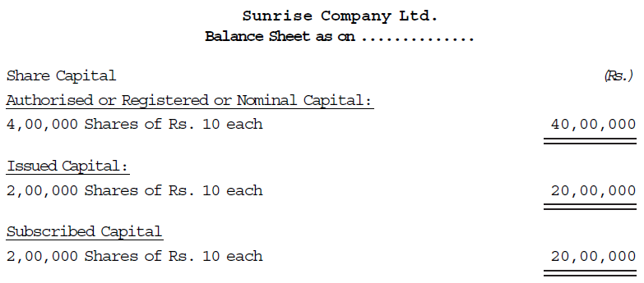
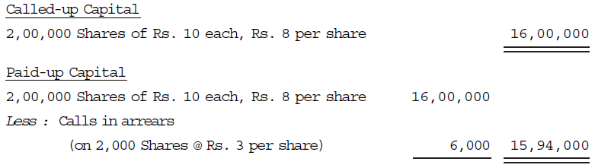
Example: Categories of Share Capital

Slide 54
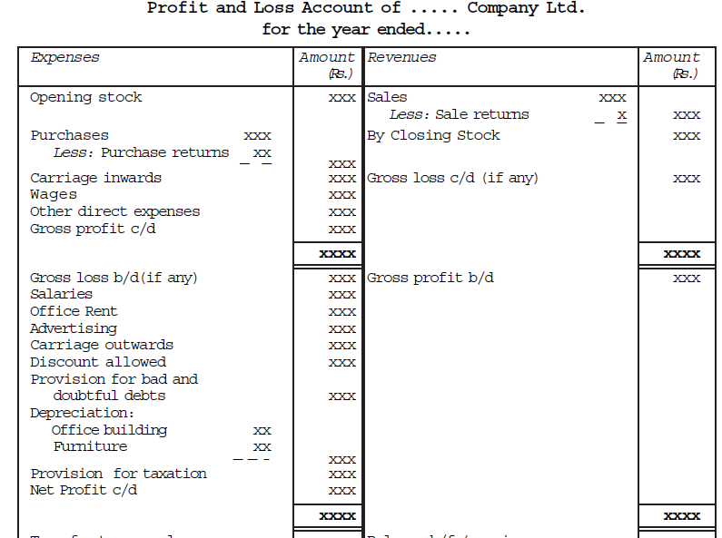
Figures for the Previous year Rs. Liabilities Figures for the current year Rs. Figures for the previous year Rs. Assets Figures for the current year Rs. 1. Share Capital 2. Reserves and surplus 3. Secured Loans 4. Unsecured Loans 5. Current Liabilities and Provisions Current Liabilities Provisions 1. Fixed Assets 2. Investments 3. Current Assets, Loans and Advances (a) Current Assets (b) Loans and Advances 4. Miscellaneous Expenditure 5. Profit and Loss A/c Trading and P&L A/c Format

Slide 55
P&L Appropriation Account Format
Particulars | Rs. | Particulars | Rs.
To Balance b/d (previous year loss) To P&L A/c (Net loss for the current year) To Dividend paid To Interim dividend To Proposed Final Dividend To Transfer to any fund or reserve To Balance c/d (Surplus) (Transfer to balance sheet) | XXX XXX XXX XXX XXX XXX XXX | By Balance b/d (previous year profit) By P&L A/c (Net profit for the current year) By Balance c/d (Deficit, if any) | XXX XXX XXX
 | XXX |  | XXX

Slide 56
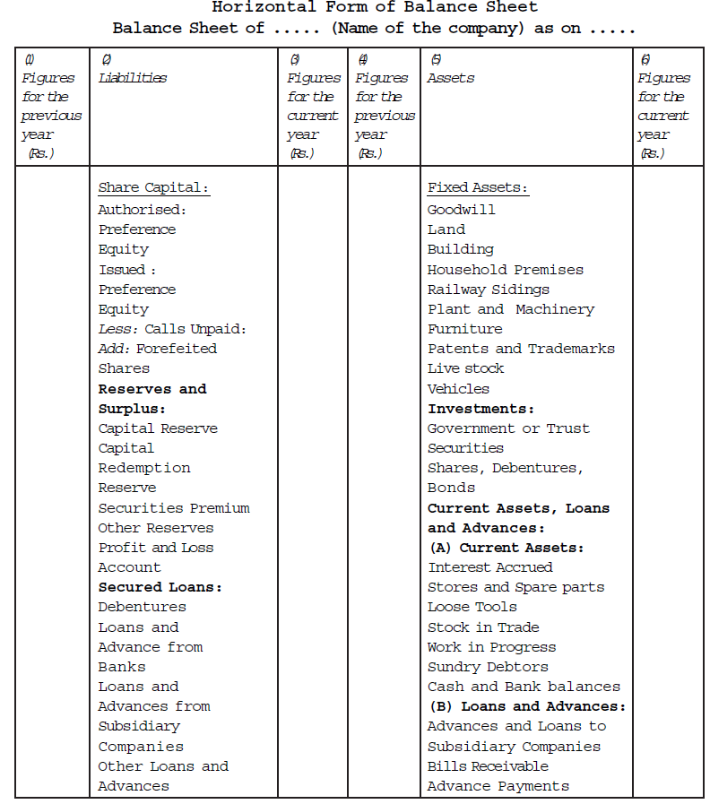
Balance Sheet

Slide 57
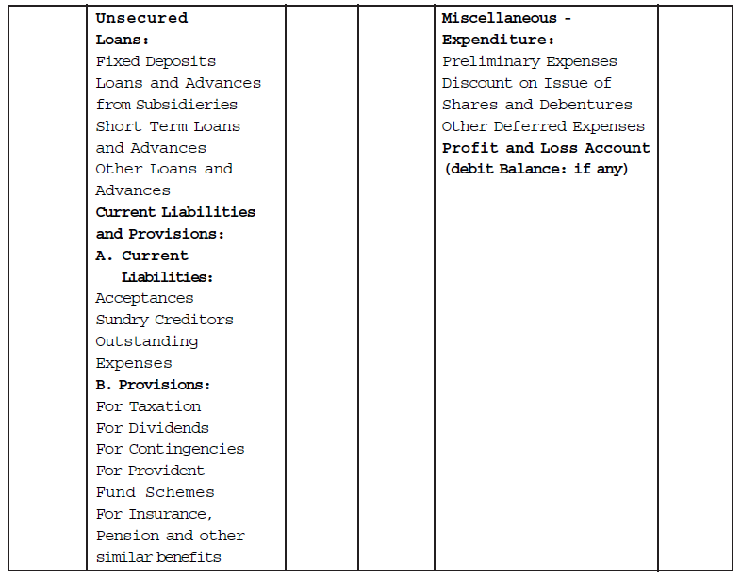
Balance Sheet (Continued)

Slide 58
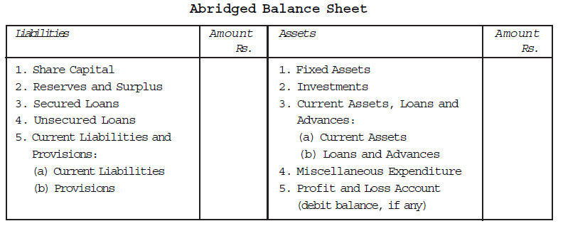
Abridged Balance Sheet

Slide 59
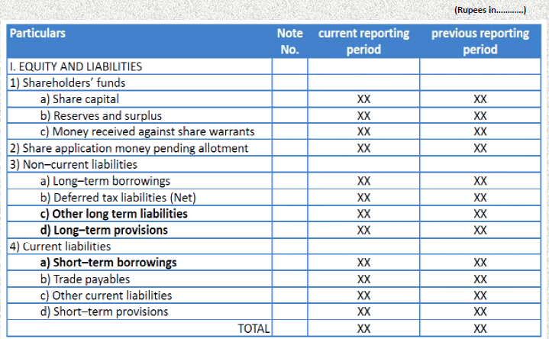
Financial Statement as per Revised Schedule VI

Slide 60
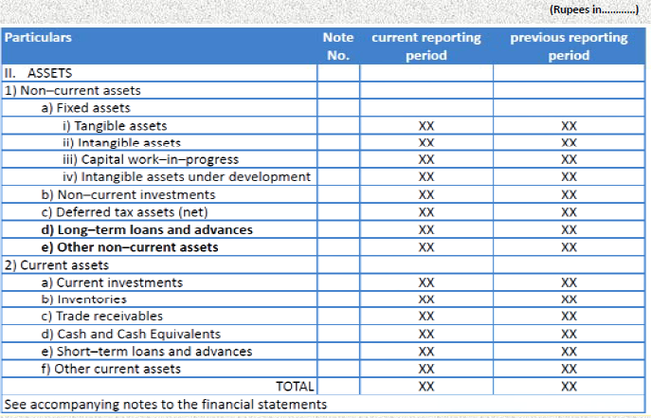

Slide 61
Key Features of Revised Schedule VI –Balance Sheet
The Revised Schedule VI has eliminated the concept of ‘schedule’ and such information is now to be furnished in the notes to accounts.
The revised schedule gives prominence to Accounting Standards (AS) i.e. in case of any conflict between the AS and the Schedule, AS shall prevail.
The revised schedule prescribes a vertical format for presentation of balance sheet therefore, no option to prepare the financial statement in horizontal format. It ensures application of uniform format.
All Assets and liabilities classified into current and non-current and presented separately on the face of the Balance Sheet.
Number of shares held by each shareholder holding more than 5% shares now needs to be disclosed.
Details pertaining to aggregate number and class of shares allotted for consideration other than cash, bonus shares and shares bought back will need to be disclosed only for a period of five years immediately preceding the Balance Sheet date.

Slide 62
Key Features of Revised Schedule VI –Balance Sheet
Any debit balance in the Statement of Profit and Loss will be disclosed under the head “Reserves and surplus.” Earlier, any debit balance in Profit and Loss Account carried forward after deduction from uncommitted reserves was required to be shown as the last item on the asset side of the Balance Sheet.
Specific disclosures are prescribed for Share Application money. The application money not exceeding the capital offered for issuance and to the extent not refundable will be shown separately on the face of the Balance Sheet. The amount in excess of subscription or if the requirements of minimum subscription are not met will be shown under “Other current liabilities.”
The term “sundry debtors” has been replaced with the term “trade receivables.” ‘Trade receivables’ are defined as dues arising only from goods sold or services rendered in the normal course of business. Hence, amounts due on account of other contractual obligations can no longer be included in the trade receivables.

Slide 63
Key Features of Revised Schedule VI –Balance Sheet
The Old Schedule VI required separate presentation of debtors outstanding for a period exceeding six months based on date on which the bill/invoice was raised whereas, the Revised Schedule VI requires separate disclosure of “trade receivables outstanding for a period exceeding six months from the date the bill/invoice is due for payment.”
“Capital advances” are specifically required to be presented separately under the head “Loans & advances” rather than including elsewhere.
Tangible assets under lease are required to be separately specified under each class of asset. In the absence of any further clarification, the term “under lease” should be taken to mean assets given on operating lease in the case of lessor and assets held under finance lease in the case of lessee.
In the Old Schedule VI, details of only capital commitments were required to be disclosed. Under the Revised Schedule VI, other commitments also need to be disclosed.

Slide 64
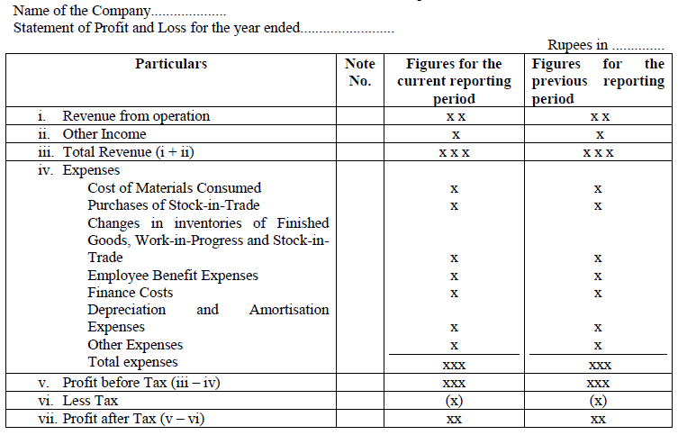
Financial Statement as per Revised Schedule VI

Slide 65
Key Features of Revised Schedule VI – Statement of Profit and Loss
The name has been changed to “Statement of Profit and Loss” as against ‘Profit and Loss Account’ as contained in the Old Schedule VI.
Unlike the Old Schedule VI, the Revised Schedule VI lays down a format for the presentation of Statement of Profit and Loss. This format of Statement of Profit and Loss does not mention any appropriation item on its face. Further, the Revised Schedule VI format prescribes such ‘below the line’ adjustments to be presented under “Reserves and Surplus” in the Balance Sheet.
As per revised schedule VI, any item of income or expense which exceeds one per cent of the revenue from operations or Rs.100,000 (earlier 1 % of total revenue or Rs.5,000), whichever is higher, needs to be disclosed separately

Slide 66
Key Features of Revised Schedule VI – Statement of Profit and Loss
In respect of companies other than finance companies, revenue from operations need to be disclosed separately as revenue from (a) sale of products, (b) sale of services and (c) other operating revenues.
Net exchange gain/loss on foreign currency borrowings to the extent considered as an adjustment to interest cost needs to be disclosed separately as finance cost.
Break-up in terms of quantitative disclosures for significant items of Statement of Profit and Loss, such as raw material consumption, stocks, purchases and sales have been simplified and replaced with the disclosure of “broad heads” only. The broad heads need to be decided based on materiality and presentation of true and fair view of the financial statements.

Slide 67
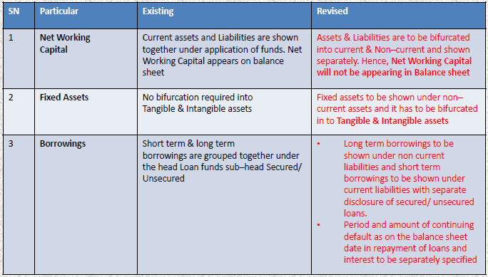
COMPARITIVE ANALYSIS BETWEEN OLD SCHEDULE VI AND REVISED SCHEDULE VI

Slide 68
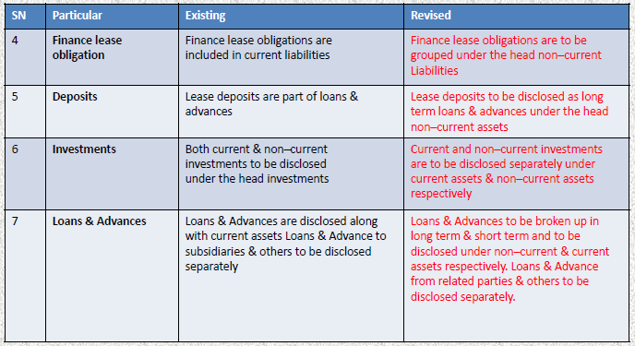
COMPARITIVE ANALYSIS BETWEEN OLD SCHEDULE VI AND REVISED SCHEDULE VI

Slide 69
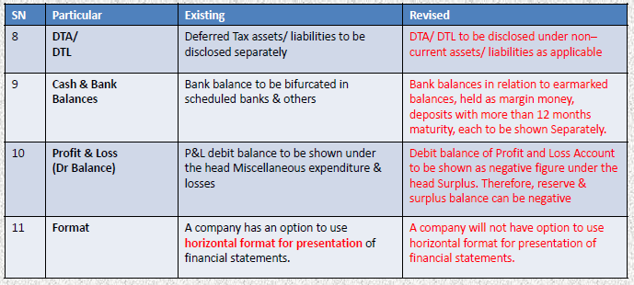
COMPARITIVE ANALYSIS BETWEEN OLD SCHEDULE VI AND REVISED SCHEDULE VI

Slide 70
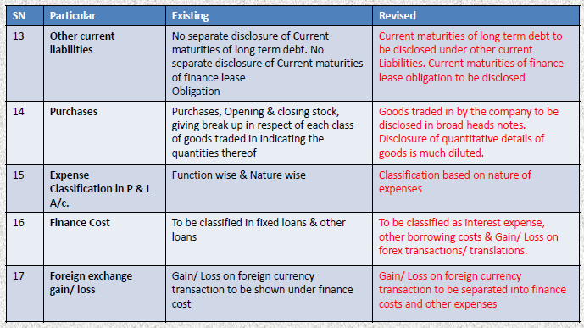
COMPARITIVE ANALYSIS BETWEEN OLD SCHEDULE VI AND REVISED SCHEDULE VI

